Slide 1
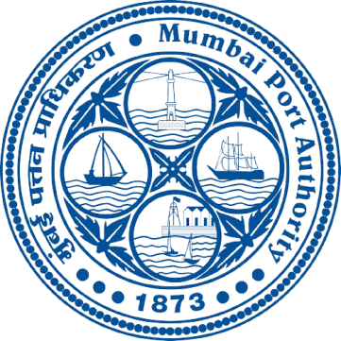
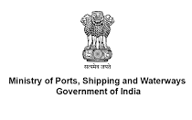
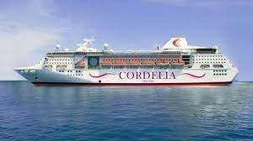
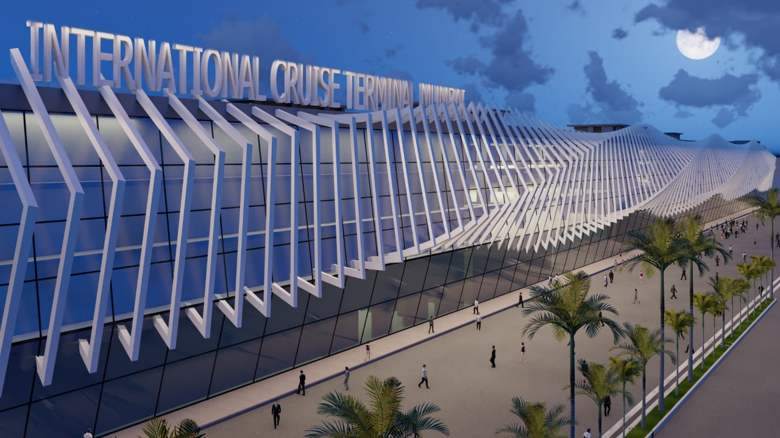
DEVELOPING PORT INFRA FOR CRUISE TOURISM

Slide 2
Status of Cruise Tourism in India
Present Scenario
Thrust area of Govt. of India. Task Force of Ministry of Shipping and Ministry of Tourism; with all stakeholders – Ports, Immigration, Tourism Boards, Port Health, Customs, Taxation body, Security, Cruise operators, Tour operators, Shipping agents, etc.
Roadmap and Action plan developed by Bermello & Ajamil.
Seven Cruise Ports developing facilities Mumbai, Goa, Mangalore, Kochi, Chennai, Vizag & Kolkata

Slide 3
 | PORTS | STATUS
1 | MUMBAI | Present Terminal being replaced by a new terminal 10 times the size. Estimated cost of Rs. 495 Crores
2 | MORMUGAO | International and Domestic Cruise Terminal at the cost of Rs.123.72 Crores.
3 | COCHIN | Existing Terminal
4 | NEW MANGALORE | Existing Terminal
5 | CHENNAI | Existing Terminal
6 | VIZAG | Estimated Cost of New Terminal Rs. 96.05 Crores
7 | KOLKATA | Estimated Cost of New Terminal Rs. 75.82 Crores

Slide 4
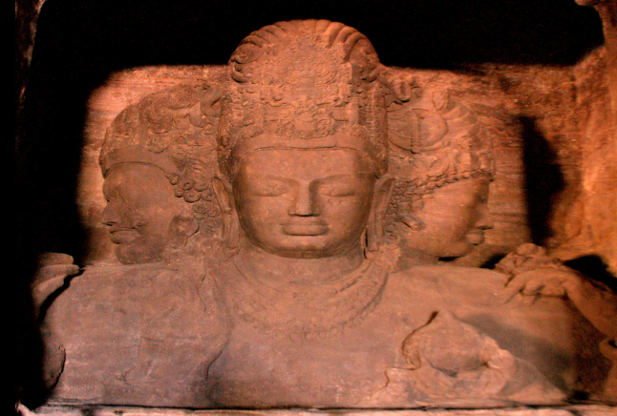
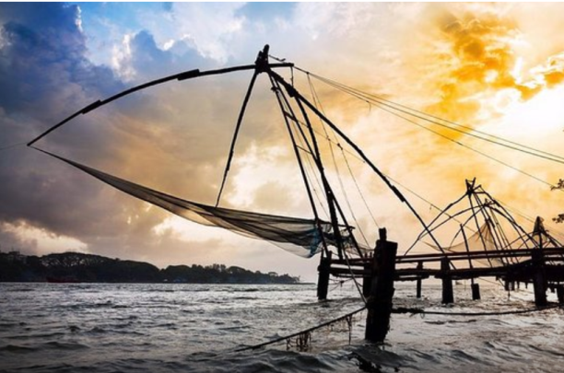
Efforts to enhance Cruise Tourism
Guaranteed berths to cruise ships
Ousting charges removed
Concessional uniform single rate for all Major ports
E-Visa and on-arrival visa facilities
Single e-Landing card introduced, valid for all ports in cruise itinerary
Cabotage waived for foreign cruise vessels
Up-gradation and Modernization of Cruise Terminal
Construction of new Cruise Terminals taken up

Slide 5
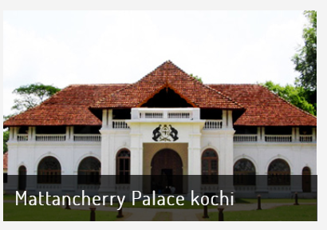
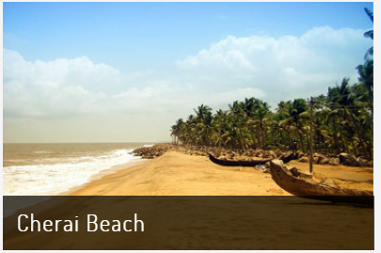
Efforts to enhance Cruise Tourism … Contd..
9. Roadmap drawn for the development of Cruise in India .
Efforts are being made for addressing GST and Customs duty Issues of Cruise stakeholders.
Participation in International Cruise Exhibition – Miami, Dubai, Azerbaijan.
Volume Discount in Port Tariff upto 20% for Domestic Cruise Ship.
Workshops/Seminars held in Mumbai for Cruise Promotion.
SOPs for Customs , Immigrations, CISF, Ports etc.
Training / sensitisation sessions held in association with Ministry of Tourism.

Slide 6
THEME BASED CIRCUITS
Under MIV Report 2030, Four themes based coastal destination circuits have been prioritized to provide initial activation to cruise demand along the Indian coastline:
Gujarat – Pilgrimage tours
Gujarat can be developed into a dedicated circuit for pilgrim tourism to tap into the existing huge market of 4 million tourists visiting Dwarka, Veraval, Somnath, Porbandar and Diu.
West Coast – Cultural and scenic tours
History and culture circuit can be developed on the Western Coast with attractions like Sindhudurg and other forts, historical, trading, temple and beach destinations and backwaters of Kerala.
South Coast – Ayurvedic wellness tours
Kerala’s coastline can be harnessed for Ayurvedic wellness and scenic tourism. Existing ports along the state, cultural heritage and biodiversity can be leveraged to build the circuit.
East Coast – Heritage tourism
Heritage attractions on the Eastern coast like Mahabalipuram, Sri Bhavanarayana Swamy Temple, can be leveraged to create heritage theme circuits, to cater to the significant demand from both domestic and foreign tourists.

Slide 7
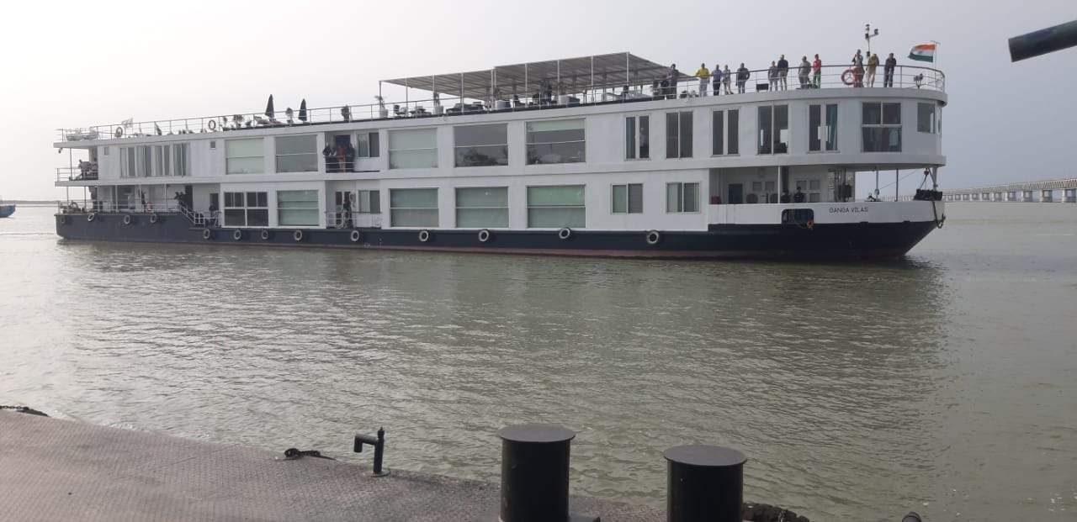
River Cruise Tourism
Inland Waterways Authority of India,
Ministry of Ports, Shipping and Waterways, Govt. of India

Slide 8
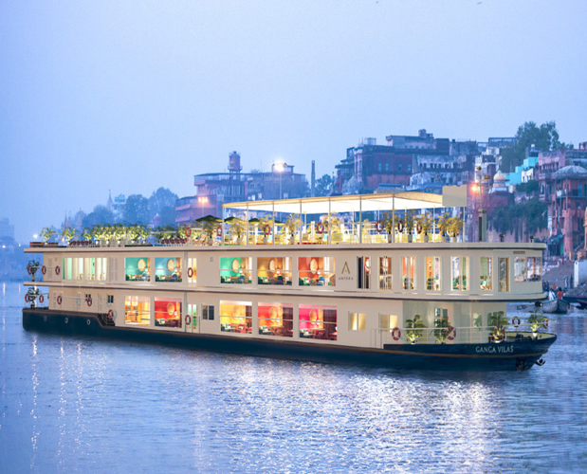
Inland Waterways – River cruise tourism
Ganga Vilas River Cruise
Steady Growth in Inland River Cruise Tourism

Slide 9
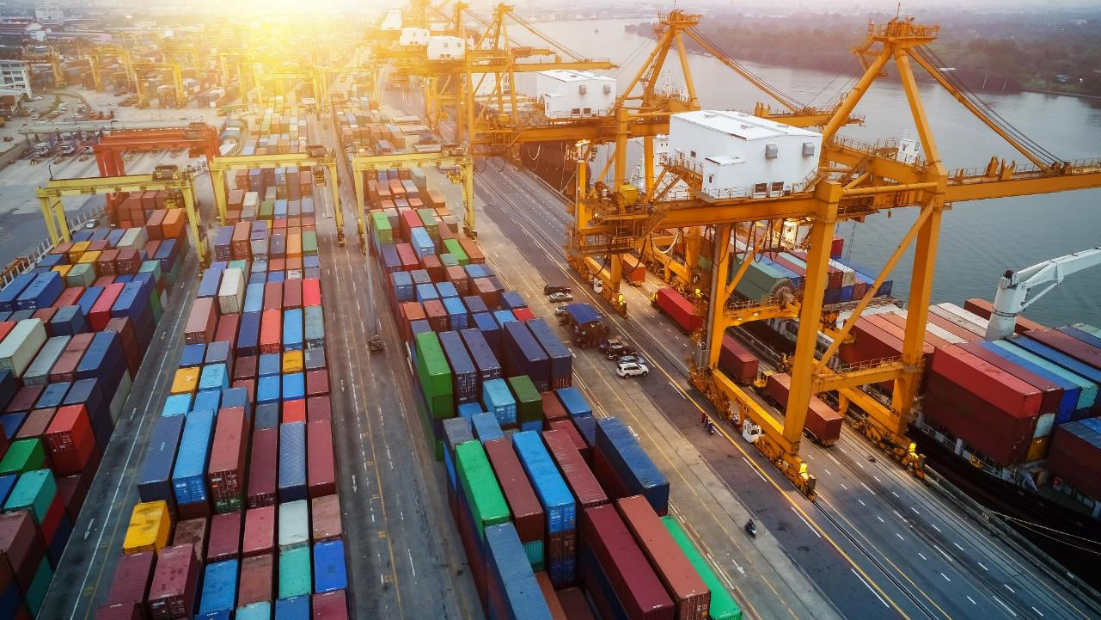
River Cruise Performance Indicator
Key River Cruise Performance Indicator | Up to 2022 | 2047
Operational waterways for River Cruise Tourism | 9 | 34
Number of Cruise Circuits with night stays | 4 | 20
Number of Ferry Tourism Circuits without night stays | 9 | 34
Number of River Cruise Terminals( permanent/ floating/landing points) | 94 | 185
Cruise Tourism Traffic with night stays | 5,000 | 1,20,000
Local Cruise Tourism Traffic on NWs without night stay | 15,00,000 | 75,00,000
Luxury Cruise Vessels (with night stays) | 14 | 60
Waterway length with operational Cruise (km) | 2096 | 5,265

Slide 10
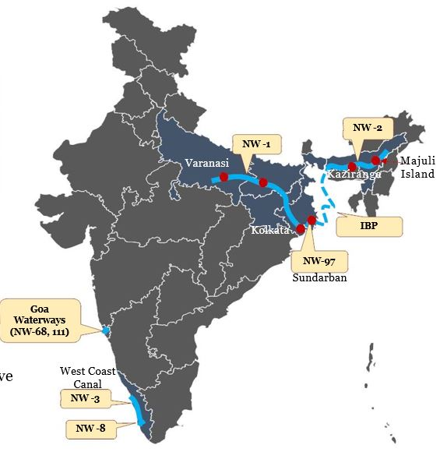
River Cruises are operational on NWs in different parts of India
National Waterway stretches where Cruise services are operational
Total
Length
(km)
1
2
3
NW-1
NW-2
NW-3
Allahabad-Haldia stretch of the
Ganga—Bhagirathi-Hooghly Rivers
1,620
891
P
P
P
Dhubri to Sadiya Stretch of
Brahmaputra River
Kollam-Kottappuram of West Coast
Canal, Champakara, Udyogmandal
365
Varanasi
Kaziranga
• Additionally, river cruises also operate on:
Kolkata
• NW-8 (Alappuzha-Changanassery Canal),
• NW-97 (Sundarban Waterways)
• Goa Waterways
• Indo Bangladesh protocol routes
• Numerous Heritage habitations, religious places, buildings, wildlife
sanctuaries, etc. located on the river banks make river cruise tourism attractive
• River Cruise tourism in India comprises high end long distance & local run
cruises
2

Slide 11
River Cruise Tourism: Impact on local Community
Would generate employment to the people of both countries in the form of cruise crew, jetty operators, language
translator, local tourist guide, local cultural artists, small boat operators etc.
Would be helpful for cultural enhancement as well as regional integration.
Would provide skilled/non-skilled employment through training of local boat operators, hoteliers and restaurants
operators to handle international tourists.
Would benefit the local markets i.e. handicrafts, local produced etc.

Slide 12
Vision for River Cruise Tourism
India is being developed as a Cruise Shipping destination as per the Maritime India Vision 2030
River cruise tourism on IBP route is being promoted to connect the tourism places on river Ganga,
Brahmaputra and rivers in Bangladesh.
IWAI is committed towards providing navigable channel for movement of river cruise on National
waterways and IBP Route.
IWAI would provide necessary terminal infrastructure for development of River Cruise Tourism

Slide 14
MUMBAI PORT AUTHORITY
TECHNICAL FEATURES OF NEW INTERNATIONAL CRUISE TERMINAL
Cruise ships upto 10000 passengers
10 Lakh pax capacity
Cruise ship handled per annum – 200
G+3 structure iconic design on cruise concept (Estimated cost – 495 Crores inclusive of PPP investment)
Total Construction Area – 4,15,000 sq.feet
Total Operational Area – 170,000 sq.feet (approx.)
No of days operations -365
Facility open to local citizens for recreation , leisure and retail
Draft available at berth – 10.5 m
Operation and Maintenance of Terminal on PPP model
Target Date of Completion – November 2024

Slide 15
MORMUGAO CRUISE TERMINAL
Status of Cruise Terminal and other Infrastructure
Status of Cruise Terminal Available | Cruise berth of 450 m length was constructed in the year 2012 and same is used for berthing of International and Domestic Cruise Vessels. Cruise Terminal G+3 building having an area of 1650 m2 was constructed in the year 2016. One no. Immigration center right at the middle of Cruise berth was constructed in the year 2020.
Status of Under Construction Cruise Terminal | Development of International and Domestic Cruise Terminal, RoPax, Ferry and other allied activities at Mormugao Port is in progress. Project Cost – Rs. 122.72 Crores
Date of completion: | September 2023
Date of operation | June 2024
Expenditure Incurred | For the quarter October to December 2022 – NIL Up to Jan.2023 : 15.97 Crores

Slide 16
MORMUGAO CRUISE TERMINAL
Other Infrastructure available/under construction (date of completion) for cruise shipping including immigration counters | Other Structure available The immigration center was provided with 24 nos. immigration Counters with all modern facilities such as Taxi counter and Forex. Facilities involves high speed broad band connectivity, CCTV, Air-conditioning offices, finishing with aluminium panelling, well placed sitting arrangement, toilet facilities. Infrastructure under Construction Terminals (Domestic and International -9,900 m2) are developed in 14.30 acres behind the existing berths 1 to 4. Terminal will handle domestic and international cruise traffic. Provision of Immigration counters, check in counters, waiting lounge, baggage carousel etc are part of the project. Commercial Ancillary Building is also part of the project -3700 m2. RoRo and RoPax facility ,Parking (5500 m2),landscaping, Separate Entry and Exit facility ,Bagging facility Provision for Duty free retail, lounges, food court, entertainment zone, snacks bars, etc are part of the project

Slide 17
NEW MANGALORE PORT AUTHORITY
Updated Status about Infrastructure development for Cruise Tourism
Infrastructure such as Immigration and Customs clearance counters, foreign exchange counters, duty free shops, handicrafts boutique, ATM etc. are operational inside the Cruise lounge since its commissioning. During the current Cruise season additional facilities like guided meditation centre, help desk by Tourism Department, heli – service, additional hospitality and cultural program by students from local University, parting gifts to the Cruise passengers etc are added for a comfortable stay at the Port.
Infrastructure development and enhancement for Domestic and International Cruise Terminal development
'Landscaping works from Cruise Terminal: The civil works portion for development of landscaping and plantation work around cruise terminal is completed.
Contd….

Slide 18
NEW MANGALORE PORT AUTHORITY
Providing PQC for Berth No. 4 (Cruise Berth) :
The work is completed.
Improvement of existing Cruise Lounge at NMPA:
Extension of Cruise lounge towards northern side for a length of 24 m x 18m to accommodate
75 Nos. of new counters has been proposed at a cost of Rs. 1.35 crores, including renovation
of the building. Area is around 432 sq.m. Estimate is under approval stage.
Construction of Cruise Terminal Gate :
Work for dedicated gate for cruise terminal was taken up by KITCO. The revised estimate as per
latest PWD S.R. 2021-22 amounting to Rs. 2.4 crores has been submitted by M/s. KITCO and the
same is under approval stage.
Construction of a Taxi Hub at Main Gate (Mallya Gate):
The Conceptual design of Taxi Hub has been submitted by the consultant. This work shall be taken
up after completion of the gates due to space constraints.

Slide 19
COCHIN PORT AUTHORITY
Infrastructure for cruise ships at CoPA
Sl. No. | Terminal Facilites | Sagarika | Samudrika | Total
1 | Date of Commissioning | 14th Feb 2021 | 2015 | -
2 | Wharf | Ernakulam | Mattancherry | -
3 | Area | 2253 sq.m. | 1800 sq.m. | 4053 sq.m.
4 | Immigration Counters | 48 | 28 | 76
5 | Customs Counters | 12 | 6 | 18
6 | Parking | 1500 sq.m. | 1000 sq.m. | 2500 sq.m.
7 | Air conditioned | Available | Available | -
8 | DFMD | 4 | 2 | 6
9 | Thermal Scanner | 2 | 1 | 3
10 | Baggage scanner | 3 | 3 | 6
11 | Public Address System | Available | Available | -
12 | CCTV Surveillance | Available | Available | -
13 | Wi-Fi Connectivity | Available | Available | -
14 | Sanitizing facility | Available | Available | -
15 | Electrical Buggies | Available | Available | -
16 | Prepaid Facility | Available | Available | -

Slide 20
CHENNAI PORT AUTHORITY
Cruise Terminal Infrastructure: • Cruise Terminal with a space of 2880 sq.mtrs can accommodate 3000 passengers. • Two Passenger Lifts, Four esclators and Heat Ventilation Air Conditioning system
provide hassle –free experience. • 40 Immigration counters for faster clearance of Passengers. • High end Security System such as Baggage Scanners ( 4 Nos), Handheld Metal Detectors,
Metal Door Frame Detectors and CCTV ensures Security and Customs purpose. • Fire Fighting System with Hydrants, smoke detectors and fire-extinguishers provide a
safe experience to the passengers. • Provision for Money Exchanger and Duty Free Shop and souvenir shopping available. • Provision for Cafeteria for refreshments.

Slide 21
VISAKHAPATNAM PORT AUTHORITY
Status of Cruise Terminal available | As on date there is no dedicated Cruise Terminal is operational at VPA
Status of Under construction Cruise terminal | A cruise terminal at an estimated cost of Rs.96.05 crores is under construction
Date of completion / Operation | Not applicable
Expenditure incurred | Rs.34.40 crores.
Other infrastructure available / under construction (date of completion) for cruise shipping including immigration counters. | Berth construction: Progress of work is 67% as against 75% Marine, touch piling work and casting and erection of precast units for berth, shore protection, walkways and mooring dolphin is in progress Terminal Building: Progress of work is 42% as against 67% Ground Floor Roof Slab is completed. First Floor Roof Slab Phase-I & Phase-II completed. Centering and reinforcement tying work for First Floor Roof Slab (Phase-III) is in progress. Plumbing work inside the building is in progress. Excavation for UG Sump and Pump Room is completed and RCC raft foundation work is in progress.

Slide 22
KOLKATA PORT AUTHORITY
Development of River Cruise Terminal and River Tourism facility alongwith river front beautification works at KDS, SMP, Kolkata.
Include Riverside landscape areas, cafeteria, Maritime interpretation Centers, Museums, etc.
Locations are indenture memorial area, Clock tower jetty as well as Takata Ghat and Outram Ghat jetties on Kolkata river side.
Planned to upgrade the Passenger terminal at 11 KPD is also being considered. A sutiable location is also being considered to accommodate International Cruise Vessels.
Estimated Project Cost – Rs. 75.82 Crores.
Commissioning – December 2025.

Slide 23
Theme based | Gujarat's coastline can be harnessed for pilgrim tourism in collaboration with tourism & local authorities
Illustrative
Potential length – 400-500 Km
# of destinations – 4-5
Demand Potential
Potential to develop dedicated circuit for pilgrim tourism to tap huge market of ~4 million tourists visiting Dwarka, Veraval, Somnath and Porbandar
Porbandar beach
Huzoor palace
Kamla Nehru park
Kirti mandir
Infrastructure Availability
Existing ports along the state coastlines could be used to develop infrastructure facilities for linking sea- land through building jetties
Okha
Dwarka
Porbandar
Local Collaboration Opportunities can be explored with:
Car rentals
Hotels
Day tour operators
Private participation in operations of
terminals
Dwarka temple
ISKCON temple
Gomti Ghat
Dwaraka lighthouse
Somnath temple
Ahmedpur Mandvi beach
Junagadh gate
Triveni sangam
Veraval
Source: Vibrant Gujarat Report

Slide 24
Theme based | History & Culture circuit could be
developed on the western coast
Illustrative
Potential length – ~1000 Km
# of destinations – 5-6
The cultural & natural attractions like Sindhudurg fort & Kerala backwaters could be leveraged to create short- medium duration cruises on small cruise boats
Starting point
Mumbai
Rua de Ourem Creek, SinquerimBaga, Anjuna-Vagator, Morjim-Keri, Aguada Fort and Aguada Jail in Goa
Sindhudurg fort
Sindhudurg
Goa
Chootad Beach, Kavvayi Backwaters, Kannavam Forest
Kannur
Backwaters, fishing villages, Kolavi beach, Azhimgham estuary
Kozhikode
Note: Ministry of Tourism has sanctioned development of Sindhudurg & Goa under coastal circuit scheme; Kannur & Kozhikode are promoted by Kerala Tourism Department
Source: Ministry of Tourism; Kerala Tourism Department; BCG Analysis

Slide 25
^{7.1.2} Theme based| Kerala’s coastline can be harnessed for Ayurvedic wellness and scenic tourism in collaboration with tourism and local authorities
Illustrative
Kozhikode
Backwaters, fishing
villages, Kolavi beach, Azhimgham estuary
Demand Potential
Kerala has been adjudged the best Ayurvedic
wellness tourism by several forums
Kochi
Ayurvedic wellness centers, Kochi Fort, Kochi Beach, Cherai Beach, Wiilingdon Island)
Infrastructure Availability
Existing ports along the state, cultural heritage and biodiversity could be leveraged to build the circuit
Local Collaboration Opportunities can be
explored with:
50+ Ayurvedic wellness centers
Car rentals
Hotels
Day tour operators
Private participation in operations of terminals
Thiruvananthapuram
Wellness centers, Ayurvedic hospitals, Peppara Wildlife Sanctuary, Kovalam
beaches, Varkala beaches)

Slide 26
Theme based | Heritage tourism circuit could be developed on the eastern coast
Illustrative
Potential length – 700-800 Km
# of destinations – 4-5
Heritage attractions on the western coast like Jyotirlingas in Mahabalipuram could be leveraged to create heritage theme circuits, which would have significant demand from both domestic & foreign tourists
Sri Bhavanarayana Swamy Temple, Draksharaman, Hope Island, Coringa Wildlife Sanctury
Kakinada
Nellore
Sri Rangaswamy temple
Mamallapuram
Shore Temple, Five Rathas,
Arjuna’s Penance
Starting point
Kochi Fort
Kochi
Rameshwaram
Jyotirlingas
Note: Ministry of Tourism has sanctioned development of Kakinada, Nellore, Mamallapuram & Rameshwaram under coastal circuit theme of
Swadesh Darshan
Source: Ministry of Tourism; BCG Analysis

